Slide 1
RI Business Leaders Alliance
4.30.25

Slide 2
7 Hospital Expense Categories Compared
US Total
RI Total

Slide 3
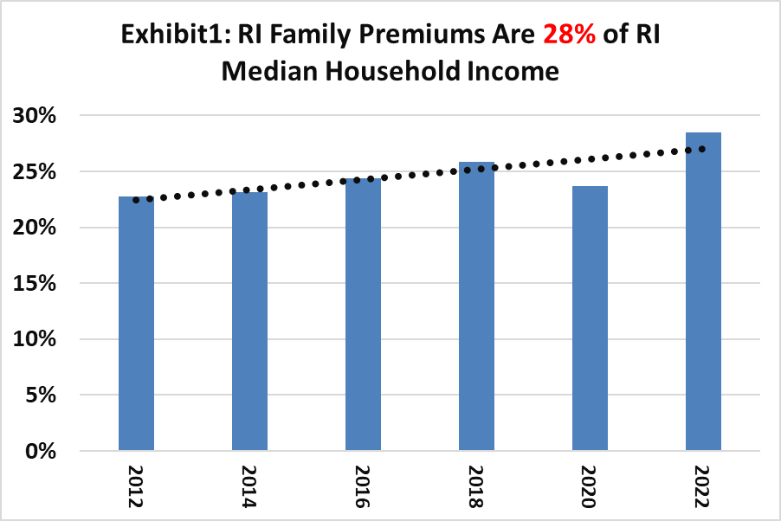
RI Family Premiums 28% MHHI
Zack Cooper, PhD, Yale School of Public Health
Higher Prices From Hospital Consolidation
Lower payroll and employment
Increases flows into unemployment
Lowers federal income tax receipts
Impact is concentrated among lower and middle-income workers.
Source: MEPS-IC

Slide 4
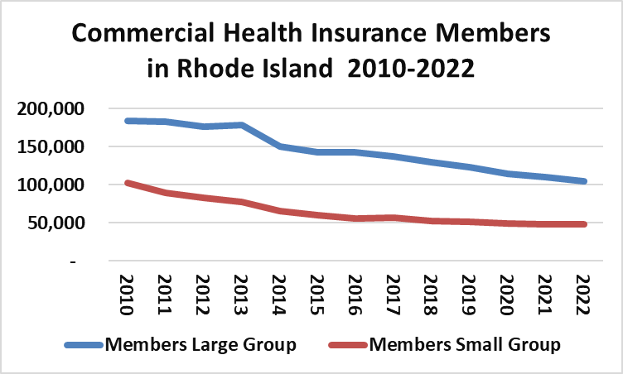

Slide 5
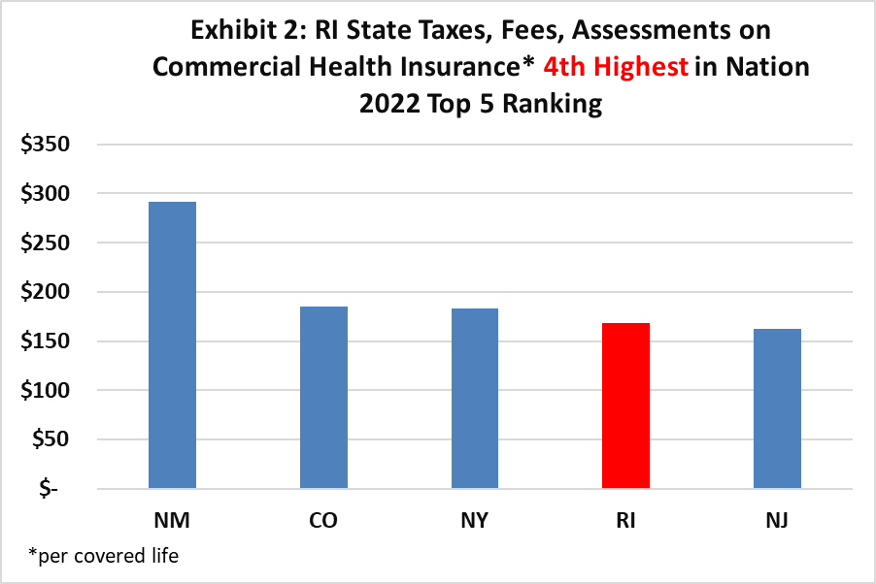
RI Taxes, Fees, Assessments 4th Highest in US
RI is 4th highest state for taxes, fees and assessments reported to NAIC.
Medicaid Directed Payments are not reported to the NAIC and amount to +/- $240million.
Source: NAIC

Slide 6
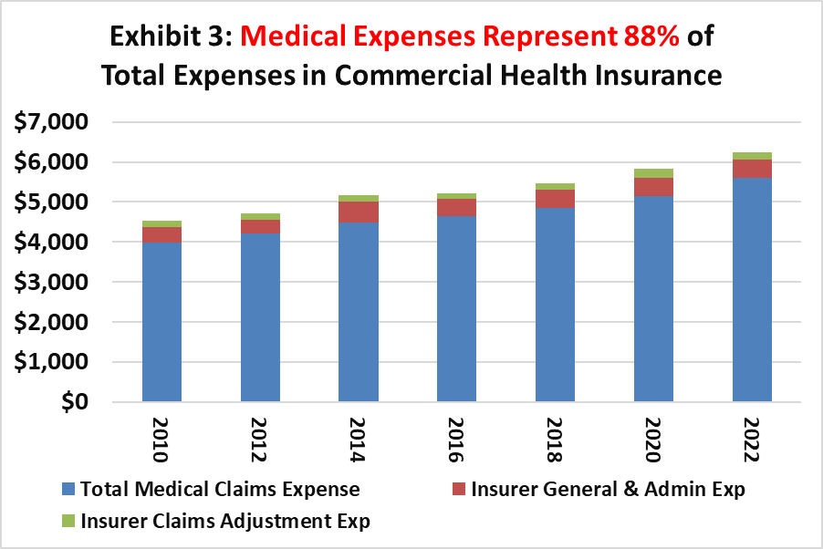
Medical Expenses Represent 88% of Total Expenses
Affordability is the goal
Every Organization needs to contribute
But the largest expense is medical claims which includes RX
Majority of research says it’s a price issue
Source: NAIC

Slide 7
NHE Compared to SERFF
National Health Expenditures (NHE)
System Electronic Rate & Form Filing (SERFF)

Slide 8
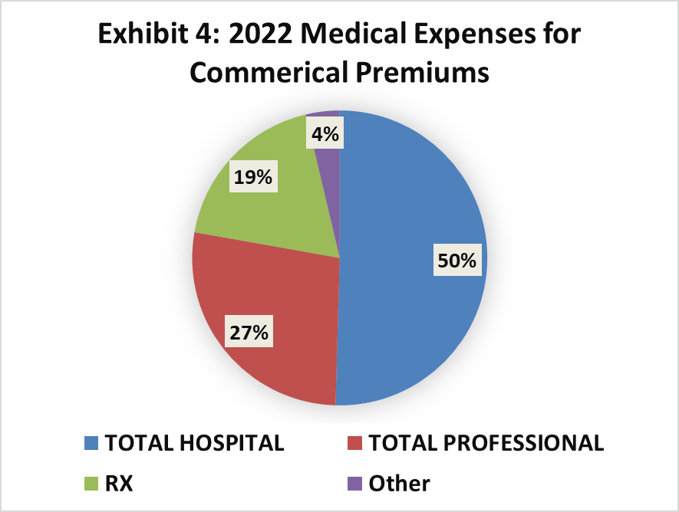
Hospital Expenses in RI are 50% of Medical Expenses
Most looked at outpatient
Inpatient expenses running at 3-5% per Year
Value asks the question what is it buying
Source: SERFF

Slide 9
Large & Small Group Commercial Health Insurance Members in Rhode Island 2010-2022

Slide 10
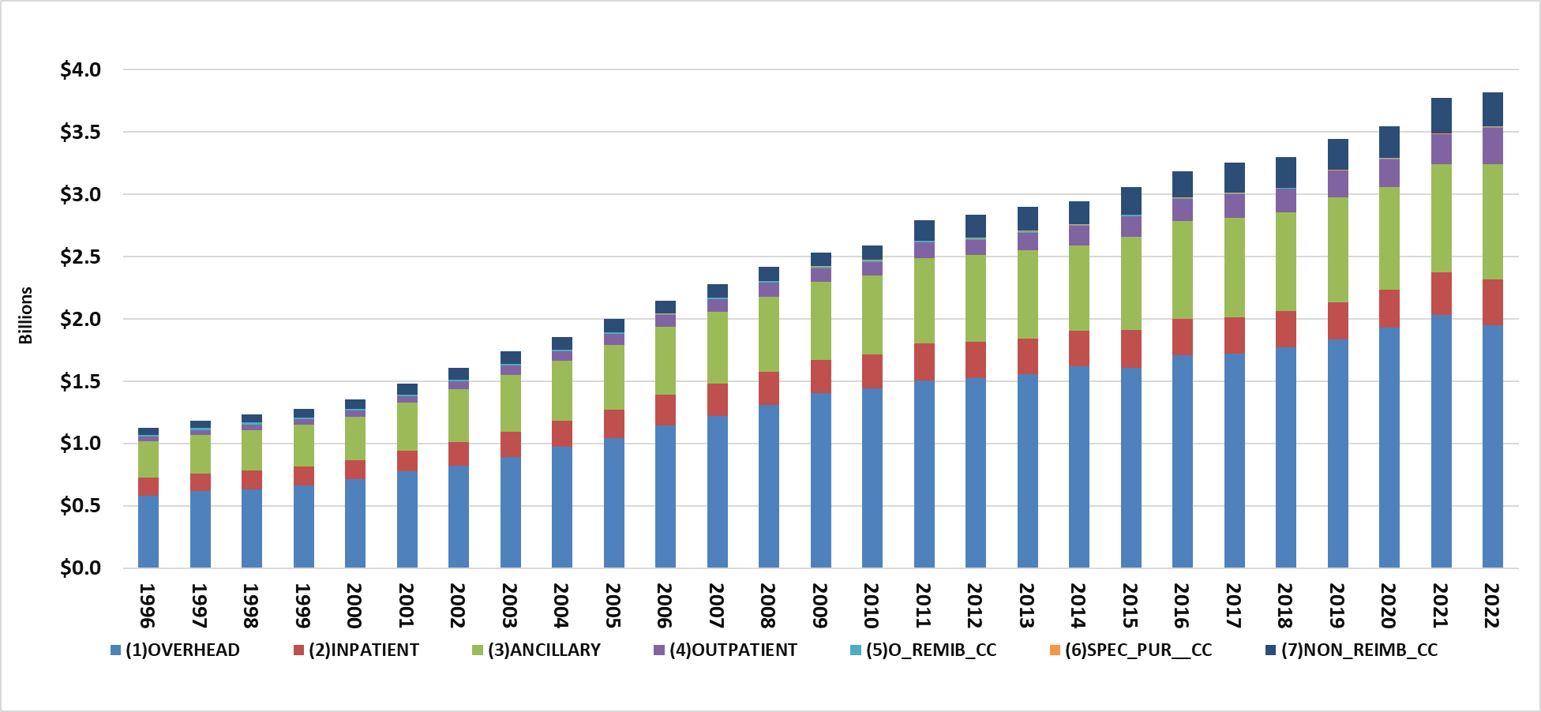
Exhibit 5: Hospital Expense Categories in RI 1996-2022
Source: HCRIS

Slide 11
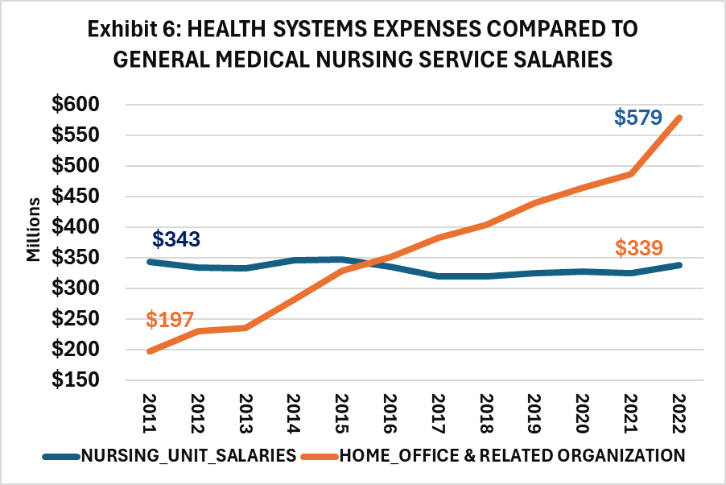
Need New Metrics to Look Under the Hood
Health System Expenses 10% per Year
Nursing Unit Salaries 3% per Year
Health Systems were Formed to
Remove Senior Management from Day-to-Day Grind. Why?
Look Strategically into Future to Deal with Many of the Issues Facing Hospitals Today
Source: HCRIS

Slide 12
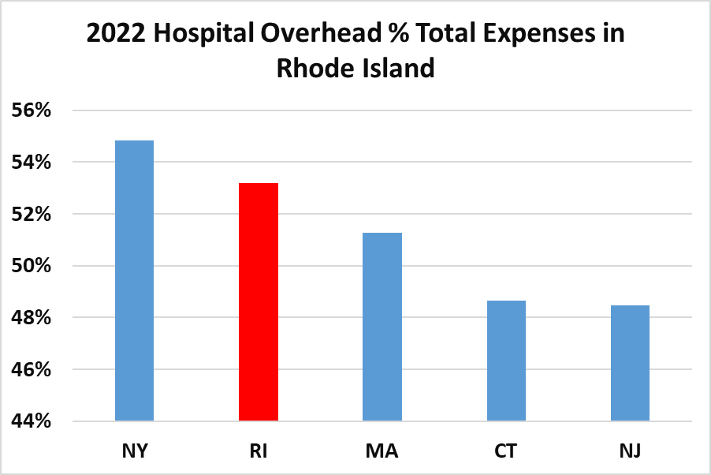
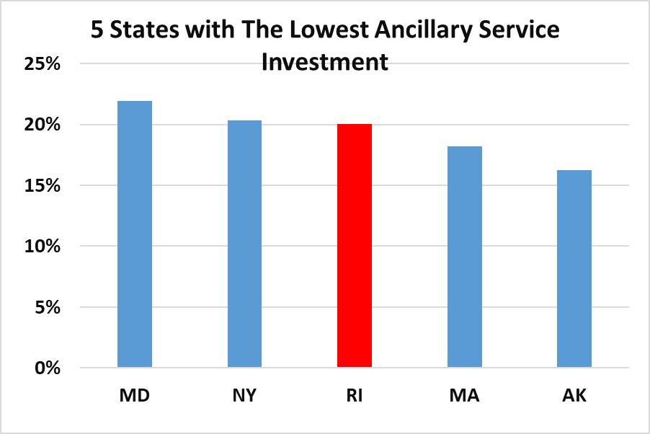
Relationship Between High Overhead Cost & Low Ancillary Investment
Source: HCRIS

Slide 13
Looking AHEAD
Fragility of Hospitals in State
Financial
Directional
Building on old model – expecting transformation
AHEAD Model
Stabilizes income
Brings focus to change

